Slide 1
Error Detection
&
Error Correction

Slide 2
Types of Errors
An error occurs when a bit is altered between transmission and reception
Single bit errors
  only one bit altered
  caused by white noise
Burst errors
  contiguous sequence of B bits in which first last and any number of intermediate bits in error
  caused by impulse noise or by fading in wireless
  effect greater at higher data rates

Slide 3

Error Detection
P_{b}: Probability that a bit is received in error; also known as
the bit error rate (BER)
P1: Probability that a frame arrives with no bit errors
P2: Probability that, with an error-detecting algorithm in
use, a frame arrives with one or more undetected errors
P3: Probability that, with an error-detecting algorithm in
use, a frame arrives with one or more detected

Slide 4

The Structure of Encoder & Decoder

Slide 5
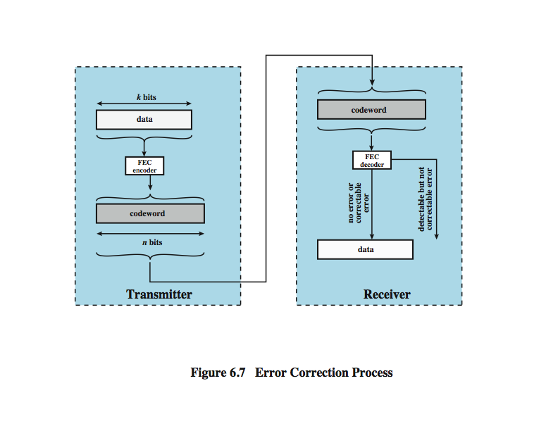
Error detection in block coding

Slide 6
Error Detection Process
Error detection is performed by calculating an error-detecting code that is a function of the bits being transmitted.
The code is appended to the transmitted bits. The receiver calculates the code based on the incoming bits and compares it to the incoming code to check for errors.
A detected error occurs if and only if there is a mismatch. There is a probability that a frame contains errors and that the error-detecting scheme will detect that fact. Also have a residual error rate, being the probability that an error will be undetected despite the use of an error-detecting scheme.

Slide 7
Error Detection Methods
Block Coding
Parity Check
Cyclic Redundancy Check

Slide 8

Block Coding
In block coding, we divide our message into blocks, each of k bits, called datawords. We add r redundant bits to each block to make the length n = k + r. The resulting n-bit blocks are called codewords

Slide 9

Example of error detection in block coding
Let us assume that k = 2 and n = 3.
Assume the sender encodes the dataword 01 as 011 and
sends it to the receiver. Consider the following cases:
1. The receiver receives 011. It is a valid codeword. The receiver extracts the dataword 01 from it.

Slide 10
2. The codeword is corrupted during transmission, and 111 is received. This is not a valid codeword and is discarded.
3. The codeword is corrupted during transmission, and 000 is received. This is a valid codeword. The receiver incorrectly extracts the dataword 00. Two corrupted bits have made the error undetectable

Slide 11
Parity Check
The simplest error-detecting scheme is to append a parity bit to the end of a block of data.
The value of this bit is selected so that the character has an even number of 1s (even parity) or an odd number of 1s (odd parity).
Note, however, that if two (or any even number) of bits are inverted due to error, an undetected error occurs. Typically, even parity is used for synchronous transmission and odd parity for asynchronous transmission.

Slide 12
Cyclic Redundancy Check
One of most common and powerful checks
For block of k bits transmitter generates an n bit frame check sequence (FCS)
Transmits k+n bits which is exactly divisible by some number
Receiver divides frame by that number
  If no remainder, assume no error
  Else error and discard the frame.

Slide 13

CRC Encoder and Decoder

Slide 14

Division in CRC encoder

Slide 15

Division in the CRC decoder for two cases

Slide 16
Example
1. Given Message D = 1010001101(10 bits)
Pattern P = 110101 (6 bits)
FCS R = to be calculated (5 bits)
2. The message is multiplied by yielding 2⁵ 101000110100000.
3. This product is divided by P:

Slide 17
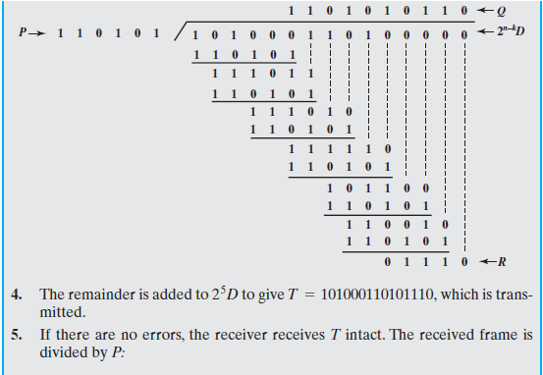

Slide 18
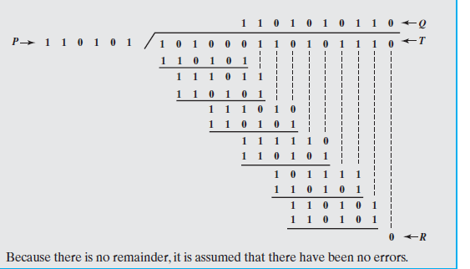

Slide 19

CRC in Polynomial
In a cyclic code,
If s(x) ≠ 0, one or more bits is corrupted.
If s(x) = 0, either
a. No bit is corrupted. or
b. Some bits are corrupted, but the
decoder failed to detect them.

Slide 20

CRC division using polynomials
Dataword 1001
Divisor 1011

Slide 21
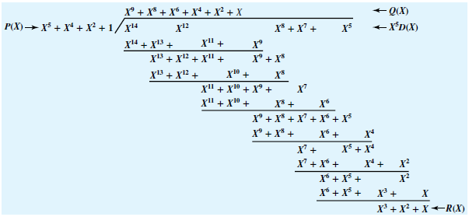
D(X) = X⁹ + X⁷ + X³ + X² + 1
P(X) = X⁵ + X⁴ + X² + 1

Slide 22
Four versions of P(X) are widely used:
        CRC-12 = X¹² + X¹¹ + X³ + X² + X + 1
        CRC-16 = X16 + X15 + X2 + 1
        CRC-CCITT = X16 + X12 + X5 + 1
        CRC-32 = X32 + X26 + X23 + X22 + X16 + X12 + X11+ X10 + X8 + X7 + X5 + X4 + X2 + X + 1

Slide 23

Error Correction

Slide 24

Example
Assume the dataword is 01. The sender creates the
codeword 01011.
The codeword is corrupted during transmission, and
01001 is received.
First, the receiver finds that the received codeword is not
in the table.This means an error has occurred.
The receiver, assuming that there is only 1 bit corrupted,
uses the following strategy to guess the correct dataword.

Slide 25
1.Comparing the received codeword with the first codeword in the table (01001 versus 00000), the receiver decides that the first codeword is not the one that was sent because there are two different bits.
2. By the same reasoning, the original codeword cannot be the third or fourth one in the table.
3. The original codeword must be the second one in the table because this is the only one that differs from the received codeword by 1 bit. The receiver replaces 01001 with 01011 and consults the table to find the dataword 01.

Slide 26

Hamming Codes
A Hamming code is a linear error-correcting code
Hamming codes can detect up to two contiguous bit errors, and correct single-bit errors;
The Hamming distance between two words is the number of differences between corresponding bits.
Let us find the Hamming distance between two pairs of words.
1. The Hamming distance d(000, 011) is 2 because
2. The Hamming distance d(10101, 11110) is 3 because

Slide 27

Structure of the Encoder and Decoder for a Hamming code

Slide 28
Hamming Codes
Redundant Bits
r0=a2+a1+a0
r1=a3+a2+a1
r2=a1+a0+a3
Syndrome Bits
s0=b2+b1+b0+q0
s1=b3+b2+b1+q1
s2=b1+b0+b3+q2

Slide 29
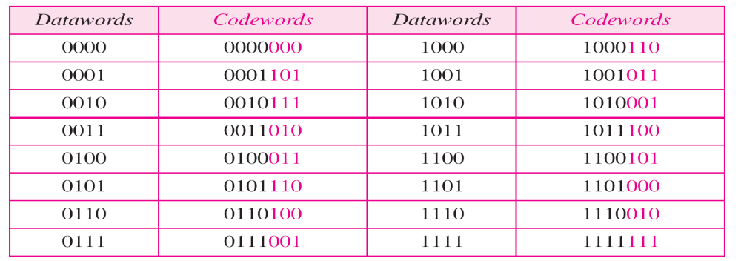

Hamming Code C(7, 4)
Logical decision made by the correction logic analyzer

Slide 30

Burst error correction using Hamming code

Slide 31
Example for Error Correction
Let us trace the path of three datawords from the sender to the destination:
1. The dataword 0100 becomes the codeword 0100011.
The codeword 0100011 is received. The syndrome is
000, the final dataword is 0100.
2. The dataword 0111 becomes the codeword 0111001.
The syndrome is 011. After flipping b2 (changing the 1
to 0), the final dataword is 0111.
3. The dataword 1101 becomes the codeword 1101000.
The syndrome is 101. After flipping b0, we get 0000,
the wrong dataword. This shows that our code cannot
correct two errors.

Slide 32
Checksum
Error detection method
A checksum is a count of the number of bits in a transmission unit that is included with the unit so that the receiver can check to see whether the same number of bits arrived.
If the counts match, it's assumed that the complete transmission was received. Else error in the transmission.
Both TCP and UDP communication layers provide a checksum count and verification as one of their services.

Slide 33
Example
If the set of numbers is (7, 11, 12, 0, 6), we send (7, 11, 12, 0, 6, 36), where 36 is the sum of the original numbers.
The receiver adds the five numbers and compares the result with the sum.
If the two are the same, the receiver assumes no error, accepts the five numbers, and discards the sum.
Otherwise, there is an error somewhere and the data are not accepted.
We can make the job of the receiver easier if we send the negative (complement) of the sum, called the checksum.
In this case, we send (7, 11, 12, 0, 6, −36). The receiver can add all the numbers received (including the checksum). If the result is 0, it assumes no error; otherwise, there is an error.

Slide 34

Checksum using One’s Complement
1 1 1 1
1 0 0 1
0 0 0 0

Slide 35
Sender Side
The sender initializes the checksum to 0 and adds all data items and the checksum.
The result is 36. However, 36 cannot be expressed in 4 bits. The extra two bits are wrapped and added with the sum to create the wrapped sum value 6.
In the figure, we have shown the details in binary. The sum is then complemented, resulting in the checksum value 9 (15 − 6 = 9). The sender now sends six data items to the receiver including the checksum 9.

Slide 36
Receiver Side
The receiver follows the same procedure as the sender. It adds all data items (including the checksum); the result is 45.
The sum is wrapped and becomes 15. The wrapped sum is complemented and becomes 0.
Since the value of the checksum is 0, this means that the data is not corrupted.
The receiver drops the checksum and keeps the other data items. If the checksum is not zero, the entire packet is dropped.

